Slide 1


Design Your API for Humans
Michael Irigoyen
Senior Software Engineer mirigoyen@accusoft.com
goyney
mririgo

Slide 2

About Me
I am Michael Irigoyen.
UI/UX design for 15+ years
PHP for 13+ years
JS for 10+ years
Node.js for 3+ years

Slide 3
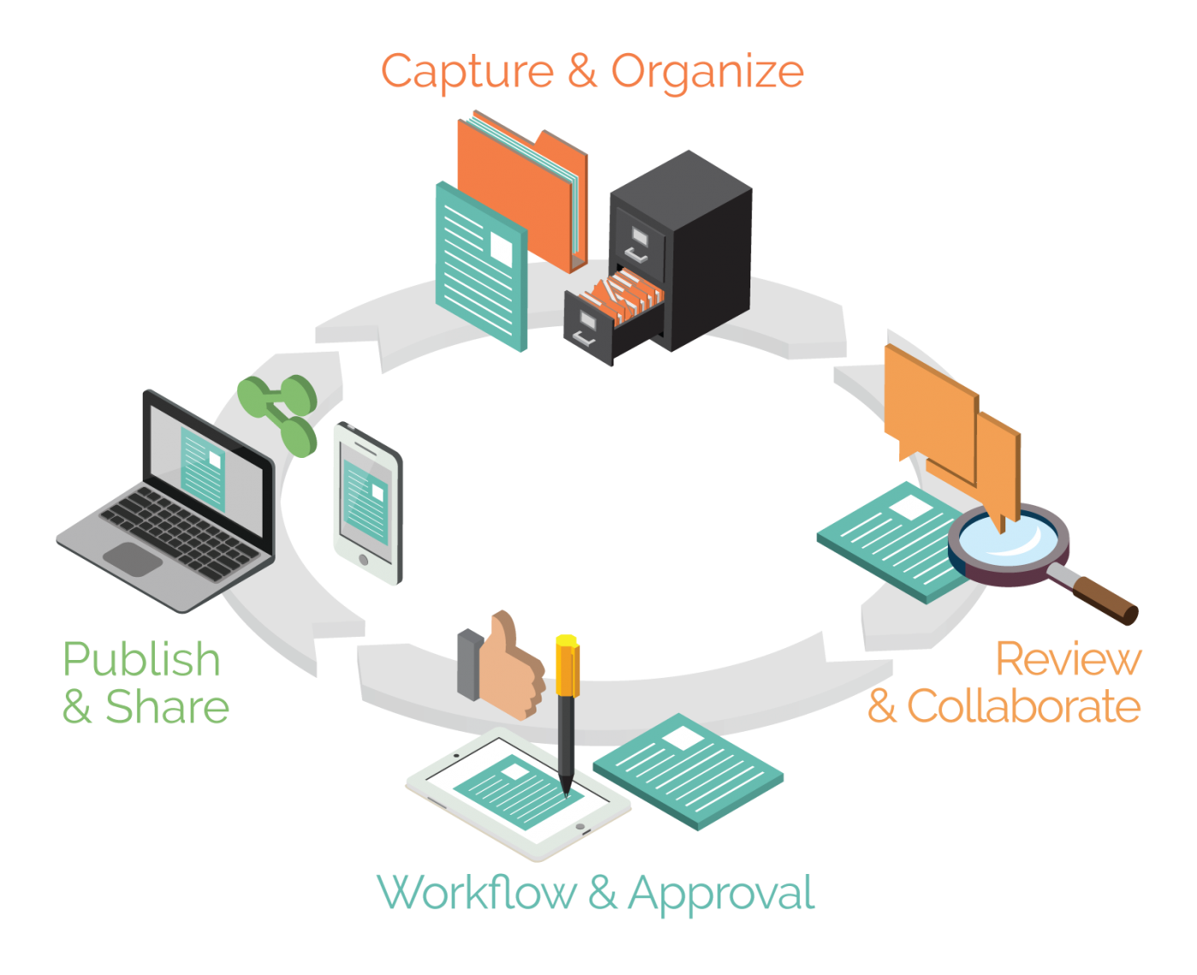
About Accusoft
Solving document lifecycle complexities with products built for developers.
Located in Tampa, FL
Founded in 1991
Awarded 30+ U.S. Patents
Creates powerful Imaging SDKs
Provides RESTful APIs for Document and Image processing

Slide 4
What is an API?
An API, or Applications Programming Interface,
is a software intermediary that allows
two applications to talk to each other.

Slide 5
What is an API?
An API, or Applications Programming Interface,
is a software intermediary that allows
a developer (usually a human being) to program
two applications to talk to each other.

Slide 6
User Experience

Slide 7
User Experience (UX)
UX is defined as “a person's perceptions and responses that result from the use or anticipated use of a product, system or service". ^{- ISO 9241-210}
UX does not apply only to user interfaces!
UX aims to enhance the customer experience
Improve usability
Create ease of access
Promote satisfaction
Notes:
UX is typically thought of to be exclusive to the user interface

Slide 8
“People ignore design that ignores people.”
Frank Chimero
Author, “The Shape of Design”
“If the user can’t use it, it doesn’t work.”
Susan Dray, Ph.D.
Usability Professionals’ Association
“Focus unswervingly on the customer.”
Jesse Hertzberg
Former COO, Squarespace
“You’re designing a product for people...”
Joey Flynn
Product Designer, Facebook
Notes:
All those complexities lead to one thing… The developer’s relationship with your API.

Slide 9
User Experience Honeycomb
useful
usable
desirable
valuable
findable
accessible
credible
- Peter Morville
Notes:
Created by Peter Morville, these 7 categories are what users are looking to get out of a product, system, or service. It’s important to strive to satisfy each category when designing and implementing an API.

Slide 10
User Experience Honeycomb
Provides functionality I need
useful
usable
desirable
valuable
findable
accessible
credible

Slide 11
User Experience Honeycomb
Provides functionality I need
Well documented and easy-to-use
useful
usable
desirable
valuable
findable
accessible
credible

Slide 12
User Experience Honeycomb
Provides functionality I need
Well documented and easy-to-use
useful
usable
desirable
Easy path to get support
valuable
findable
accessible
credible

Slide 13
User Experience Honeycomb
Provides functionality I need
Well documented and easy-to-use
useful
usable
desirable
Easy path to get support
valuable
Output is organized and manageable
findable
accessible
credible

Slide 14
User Experience Honeycomb
Provides functionality I need
Well documented and easy-to-use
useful
usable
desirable
Easy path to get support
valuable
Output is organized and manageable
findable
accessible
credible
Interface is secure and has a legitimate URI

Slide 15
User Experience Honeycomb
Provides functionality I need
Well documented and easy-to-use
useful
usable
desirable
Easy path to get support
valuable
Output is organized and manageable
findable
accessible
credible
Consistent, versioned interface
Interface is secure and has a legitimate URI

Slide 16
User Experience Honeycomb
Provides functionality I need
Well documented and easy-to-use
useful
usable
desirable
Easy path to get support
valuable
Output is organized and manageable
findable
accessible
credible
Consistent, versioned interface
Interface is secure and has a legitimate URI

Slide 17
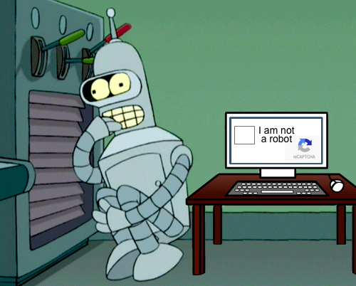
Design Your API for Humans
Throw away the notion of building something for a computer to consume
Humans are the ones integrating your API
Determine what your users need to successfully and easily implement your interface

Slide 19
mirigoyen@accusoft.com
goyney
mririgo

